Slide 1
Data Transmission

Slide 2
Outline
Concepts and Terminology
Analog and Digital Data Transmission
Transmission Impairments
Channel Capacity

Slide 3
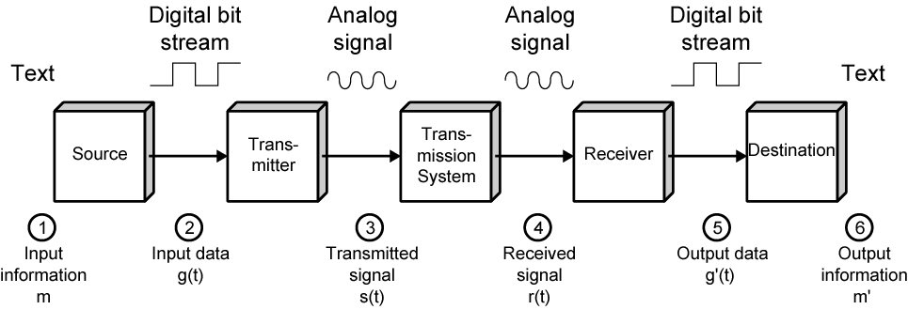
Part 1: Concepts and Terminology
Simplified Communications Model

Slide 4
Digital Data Transmission
Each single bit can be represented by a signal element.
Each signal element takes some time to send.
Bit rate: the number of bits that can be sent out per unit of time.
1
1
0
0
1
1
1
0
0
time

Slide 5
What is the objective?
Maximize the data rate: number of bits that the system can transmit in a unit of time
  within an acceptable bit error rate
Why there could be bit errors?
  The signal received by the receiver is different from the signal sent from the sender
Usually, if data rate becomes higher, it is more difficult for the receiver to recognize the signal
  higher data rate results in higher bit error rate
In order to achieve high data rate with low bit error rate, we need to study the principle of data communications

Slide 6
Terminology (1)
Data transmission occurs between transmitter and receiver over some transmission medium.
Signal: electromagnetic waves
  Can propagate along the transmission medium
Transmission Medium
  Guided medium: the signals are guided along a physical path
    e.g., twisted pair, coaxial cable, optical fiber
  Unguided medium: wireless
    e.g., air, water, vacuum

Slide 7
Terminology (2)
Direct link
  Refer to the transmission path between the transmitter and receiver in which signals propagate directly with no intermediate devices, other than amplifiers or repeaters used to increase signal strength.
  Note that it can apply to both guided and unguided media
A transmission medium is point-to-point if:
  Direct link
  Only 2 devices share the medium
A transmission medium is multipoint if:
  More than two devices share the same medium
Point-to-point
Multipoint

Slide 8
Terminology (3)
Simplex transmission
  Signals are transmitted in only one direction
    e.g. Television
Half duplex
  Signals can be transmitted in either direction, but only one way at a time.
    e.g. police radio
Full duplex
  Both stations may transmit simultaneously.
    e.g. telephone

Slide 9
Signals: Time Domain
We are concerned with electromagnetic signals used as a means to transmit data.
A signal is generated by the transmitter and transmitted over a medium.
The signal is a function of time, but it can also be expressed as a function of frequency.
Time domain concepts: an electromagnetic signal can be either analog or digital
  Analog signal
    The signal intensity varies in a smooth fashion over time. Or, there is no breaks or discontinuities in the signal.
  Digital signal
    The signal intensity maintains a constant level for some period of time and then changes to another constant level.
Time domain function of a signal: s(t)
  Specifies the amplitude (in volts) of the signal at each instant in time.

Slide 10
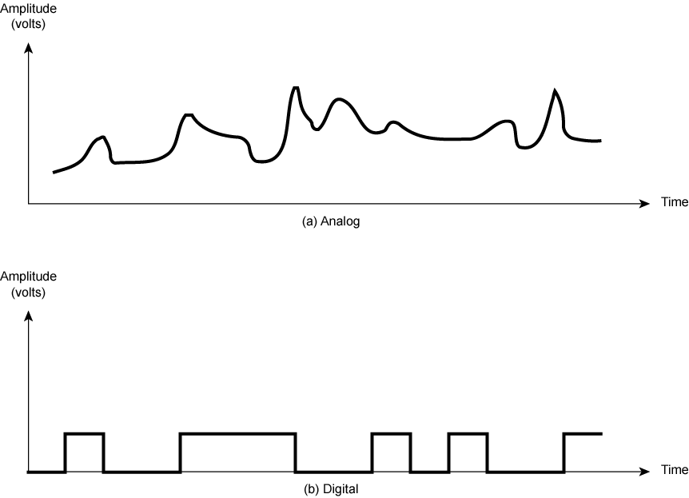
Analogue & Digital Signals

Slide 11
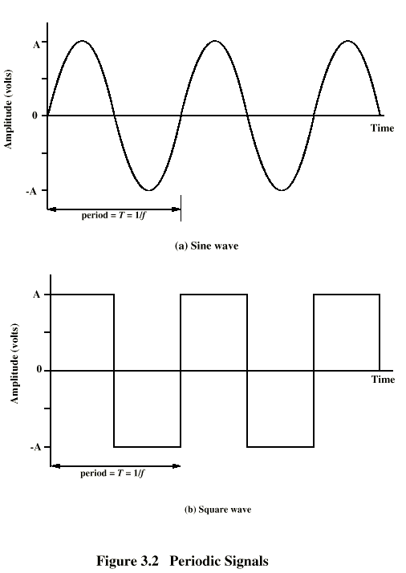
Periodic
Signals
Concept of periodic signal
The same signal pattern repeats over time.
Otherwise, a signal is aperiodic.
Peak Amplitude (A)
  maximum strength of signal
  measured in volts
Frequency (f)
  Rate of change of signal
  Hertz (Hz) or cycles per second
  Period = time for one repetition (T)
  T = 1/f
Phase (φ)
  Relative position in time within a single period of a signal
Figure (a) displays the value of a signal at a given point in space as a function of time.

Slide 12
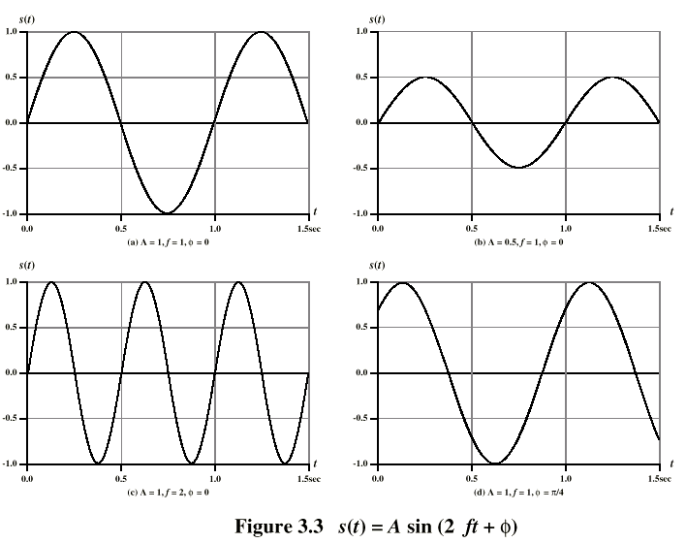
Varying Sine Waves

Slide 13
Spectrum & Bandwidth
Spectrum of a signal
  the range of frequencies contained in the signal
Absolute bandwidth of a signal
  the width of the signal spectrum
  Many signals have an infinite bandwidth!
Effective bandwidth of a signal
  often just referred to as bandwidth
  the narrow band of frequencies containing “most” of the signal energy
DC Component (dc: direct current)
  the component of zero frequency (i.e., f = 0)
  With no dc component, a signal has an average amplitude of zero.
  With a dc component, a signal has a frequency term at f = 0 and a nonzero average amplitude.

Slide 14
Data Rate and Bandwidth
Effective bandwidth is the band within which most of the signal energy is concentrated. Here, “most” is somewhat arbitrary.
Although a given waveform may contain frequencies over a very broad range, as a practical matter, any transmission system will be able to accommodate only a limited band of frequencies.
  because of the limitation of transmitter & medium & receiver
  This limits the data rate that can be carried on the transmission system.

Slide 15
Effective Bandwidth
Effective bandwidth is one property of transmission system.
If the effective bandwidth of the input signal is larger than the bandwidth of transmission system, the output signal will be distorted a lot!
The signal’s bandwidth should match the bandwidth supported by the transmission system.
Input signal
Output signal
Transmission System

Slide 16
Part 2: Analog and Digital Data Transmission
The two terms “analog” and “digital” are used frequently in the following three contexts:
  Data
    Entities that convey meaning or information
  Signals
    electromagnetic representations of data
  Transmission
    The communication of data by the propagation and processing of signals
Analog: continuous
Digital: discrete

Slide 17
Analog and Digital Data
Analog data
  Continuous values within some interval
    Represented by real numbers
  How aloud is the sound?
  How bright is the color?
  What is your weight?
Digital data
  Discrete values, e.g., text, integers
Computers use digital data
  Even double precision floating numbers are discrete!
  In practice, digital data are used to approximate analog data
    E.g., the brightness of color can be represented by 0, 1, …, 255
    The loudness of the sound can be represented by 0, 1, …, 255
  Digital data are stored as bit stream in computers.
Digitized into digital data

Slide 18
Analog and Digital Signals
In a communication system, data are propagated from one point to another by means of electromagnetic signals.
Now we consider the signal generated by the transmitter.
Analog signal
  Propagated over a variety of media: wire, fiber optic, space
  Continuously varying according to the source information
    Speech bandwidth: 100Hz to 7kHz
    Video bandwidth: 4MHz
Digital signal
  A sequence of voltage pulses
  Almost unlimited bandwidth

Slide 19
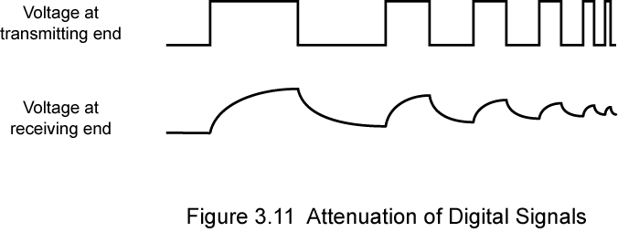
Advantages & Disadvantages of Digital Signals
Generally cheaper than analog signaling
Less susceptible to noise
Suffer more from attenuation!
  Pulses become rounded and smaller
  Leads to loss of information

Slide 20
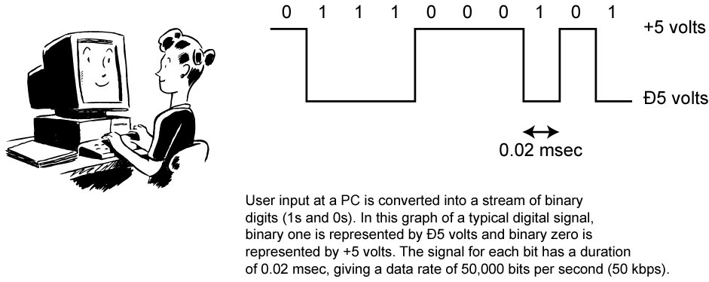
Bit Stream to Digital Signal

Slide 21
Data and Signals
Usually, we use digital signals for digital data and analog signals for analog data
  Analog data are a function of time and occupy a limited frequency spectrum; such data can be represented by an electromagnetic signal occupying the same spectrum.
  Digital data can be represented by digital signals, with a different voltage level for each of the two binary digits.
Can use analog signal to carry digital data
  Modem: modulator/demodulator
  The modem converts a series of binary voltage pulses into an analog signal by encoding the digital data onto a carrier frequency.
Can use digital signal to carry analog data
  Codec (coder-decoder): the codec takes an analog signal that directly represents the voice data and approximates that signal by a bit stream. At the receiving end, the bit stream is used to reconstruct the analog data.

Slide 22
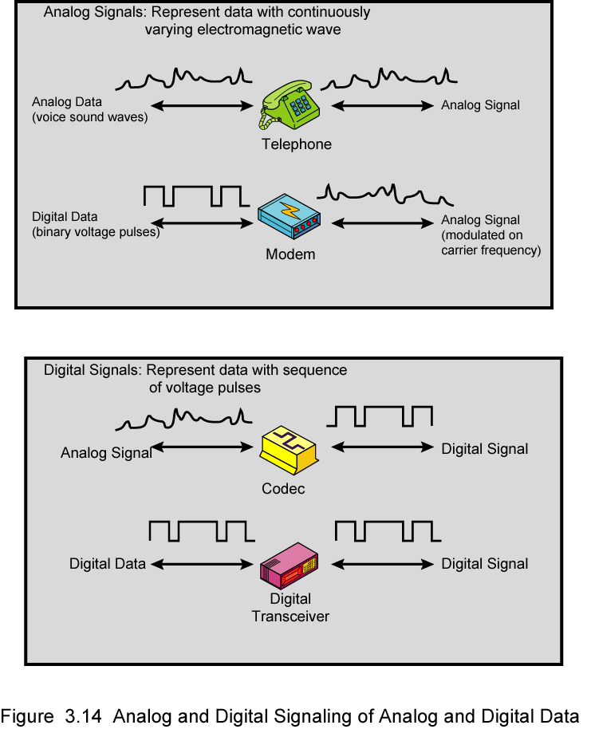
Analog Signals Carrying Analog and Digital Data

Slide 23
Digital Signals Carrying Analog and Digital Data
Analog Data

Slide 24
Analog Transmission
Analog transmission is a means of transmitting analog signals without regard to their content.
  The signals may represent analog or digital data.
  In either case, the analog signal will become weaker after a certain distance.
  Therefore, the analog transmission system includes amplifiers to boost the energy in the signal.
  Unfortunately, the amplifier also amplifies noise.
  With amplifiers cascaded to achieve long distances, the signal becomes more and more distorted.
    For analog data such a voice, quite a bit of distortion can be tolerated and the data remain intelligible.
    For digital data, cascaded amplifiers will introduce bit errors.

Slide 25
Digital Transmission
Digital transmission is concerned with the content of the signal.
  It can use digital signal, or analog signal.
Repeaters are used instead of amplifiers
  A repeater receives the signal, recovers the pattern of 1s and 0s, regenerates the signal, and retransmits the signal.
  Amplifiers cannot do this, as the signal has no meaning of 0 or 1
Attenuation is overcome, noise is not cumulative.

Slide 26
Advantages of Digital Transmission
Digital transmission techniques are widely used because of the following advantages:
  Digital technology
    The advent of low cost LSI/VLSI technology has caused a continuing drop in the cost and size of digital circuitry.
  Data integrity
    With the use of repeaters, the effects of noise and other impairments are not cumulative. Thus it is possible to transmit data longer distances and over lower quality lines while maintaining the integrity of the data.
  Capacity utilization
    High bandwidth links become economical.
    High degree of multiplexing is easier with digital techniques.
  Security & Privacy
    Encryption technique can be readily applied to digital data and to analog data that have been digitized.
  Integration
    By treating both analog and digital data digitally, all signals have the same form and can be treated similarly. Thus economies of scale and convenience can be achieved by integrating voice, video, and digital data.

Slide 27
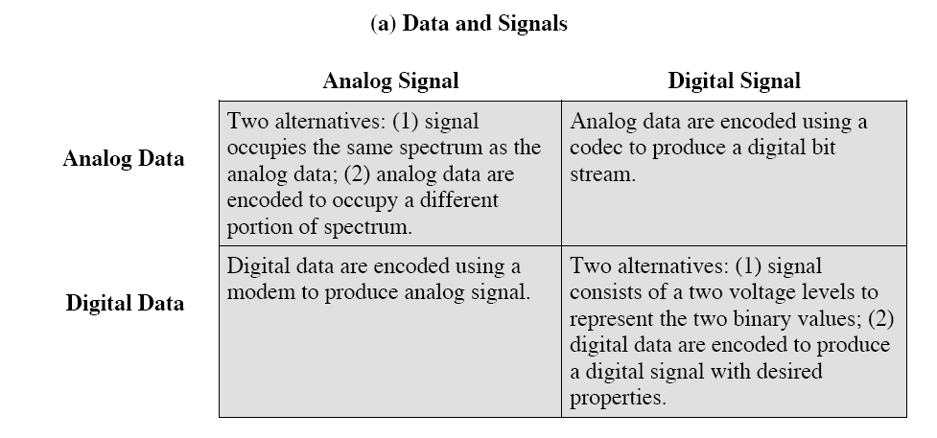
Summary of data transmission

Slide 28
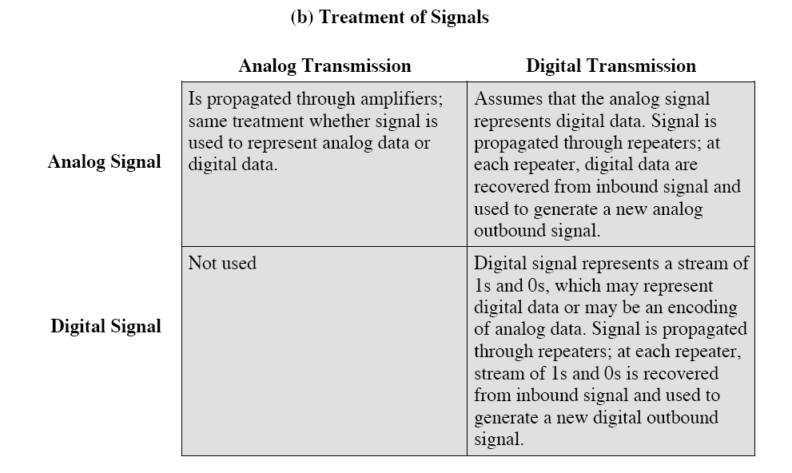
Summary of data transmission

Slide 29
Part 3: Transmission Impairments
With any communications system, the signal that is received may differ from the signal that is transmitted, due to various transmission impairments.
Consequences:
  For analog signals: degradation of signal quality
  For digital signals: bit errors
The most significant impairments include
  Attenuation and attenuation distortion
  Delay distortion
  Noise

Slide 30
Attenuation
Attenuation: signal strength falls off with distance.
Depends on medium
  For guided media, the attenuation is generally exponential and thus is typically expressed as a constant number of decibels per unit distance.
  For unguided media, attenuation is a more complex function of distance and the makeup of the atmosphere.
Three considerations for the transmission engineer:
  A received signal must have sufficient strength so that the electronic circuitry in the receiver can detect the signal.
  The signal must maintain a level sufficiently higher than noise to be received without error.
These two problems are dealt with by the use of amplifiers or repeaters.

Slide 31
Attenuation Distortion
(Following the previous slide)
3. Attenuation is often an increasing function of frequency. This leads to attenuation distortion:
  some frequency components are attenuated more than other frequency components.
Attenuation distortion is particularly noticeable for analog signals: the attenuation varies as a function of frequency, therefore the received signal is distorted, reducing intelligibility.

Slide 32
Delay Distortion
Delay distortion occurs because the velocity of propagation of a signal through a guided medium varies with frequency.
Various frequency components of a signal will arrive at the receiver at different times, resulting in phase shifts between the different frequencies.
Delay distortion is particularly critical for digital data
  Some of the signal components of one bit position will spill over into other bit positions, causing intersymbol interference, which is a major limitation to maximum bit rate over a transmission channel.

Slide 33
Noise (1)
For any data transmission event, the received signal will consist of the transmitted signal, modified by the various distortions imposed by the transmission system, plus additional unwanted signals that are inserted somewhere between transmission and reception.
The undesired signals are referred to as noise, which is the major limiting factor in communications system performance.
Four categories of noise:
  Thermal noise
  Intermodulation noise
  Crosstalk
  Impulse noise

Slide 34
Noise (2)
Thermal noise (or white noise)
  Due to thermal agitation of electrons
  It is present in all electronic devices and transmission media, and is a function of temperature.
  Cannot be eliminated, and therefore places an upper bound on communications system performance.
Intermodulation noise
  When signals at different frequencies share the same transmission medium, the result may be intermodulation noise.
  Signals at a frequency that is the sum or difference of original frequencies or multiples of those frequencies will be produced.
  E.g., the mixing of signals at f1 and f2 might produce energy at frequency f1 + f2. This derived signal could interfere with an intended signal at the frequency f1 + f2.

Slide 35
Noise (3)
Crosstalk
  It is an unwanted coupling between signal paths. It can occur by electrical coupling between nearby twisted pairs.
  Typically, crosstalk is of the same order of magnitude as, or less than, thermal noise.
Impulse noise
  Impulse noise is non-continuous, consisting of irregular pulses or noise spikes of short duration and of relatively high amplitude.
  It is generated from a variety of cause, e.g., external electromagnetic disturbances such as lightning.
  It is generally only a minor annoyance for analog data.
  But it is the primary source of error in digital data communication.

Slide 36
Part 4: Channel Capacity
The maximum rate at which data can be transmitted over a given communication channel, under given conditions, is referred to as the channel capacity.
Data rate
  The rate in bits per second (bps) at which data can be communicated
Bandwidth
  In cycles per second, or Hertz
  Constrained by transmitter and the nature of the medium
Error rate
  The rate at which errors occur, where an error is the reception of a 1 when a 0 was transmitted or the reception of a 0 when a 1 was transmitted.
We would like to make as efficient use as possible of a given bandwidth, i.e., we would like to get as high a data rate as possible at a particular limit of error rate for a given bandwidth.

Slide 37
Two Formulas
Problem: given a bandwidth, what data rate can we achieve?
Nyquist Formula
  Assume noise free
Shannon Capacity Formula
  Assume white noise

Slide 38
Nyquist Formula
Assume a channel is noise free.
Nyquist formulation: if the rate of signal transmission is 2B, then a signal with frequencies no greater than B is sufficient to carry the signal rate.
  Given bandwidth B, highest signal rate is 2B.
Why is there such a limitation?
  due to intersymbol interference, such as is produced by delay distortion.
Given binary signal (two voltage levels), the maximum data rate supported by B Hz is 2B bps.
  One signal represents one bit

Slide 39
Nyquist Formula
Signals with more than two levels can be used, i.e., each signal element can represent more than one bit.
  E.g., if a signal has 4 different levels, then a signal can be used to represents two bits: 00, 01, 10, 11
With multilevel signaling, the Nyquist formula becomes:
  C = 2B log₂M
  M is the number of discrete signal levels, B is the given bandwidth, C is the channel capacity in bps.
  How large can M be?
    The receiver must distinguish one of M possible signal elements.
    Noise and other impairments on the transmission line will limit the practical value of M.
Nyquist’s formula indicates that, if all other things are equal, doubling the bandwidth doubles the data rate.

Slide 40
Shannon Capacity Formula
Now consider the relationship among data rate, noise, and error rate.
Faster data rate shortens each bit, so burst of noise affects more bits
  At given noise level, higher data rate results in higher error rate
All of these concepts can be tied together neatly in a formula developed by Claude Shannon.
  For a given level of noise, we would expect that a greater signal strength would improve the ability to receive data correctly.
  The key parameter is the SNR: Signal-to-Noise Ratio, which is the ratio of the power in a signal to the power contained in the noise.
  Typically, SNR is measured at receiver, because it is the receiver that processes the signal and recovers the data.
For convenience, this ratio is often reported in decibels
  SNR = signal power / noise power
  SNR_{db}⁼ 10 log₁₀ (SNR)

Slide 41
Shannon Capacity Formula
Shannon Capacity Formula:
  C = B log₂(1+SNR)
  Only white noise is assumed. Therefore it represents the theoretical maximum that can be achieved.
This is referred to as error-free capacity.
Some remarks:
  Given a level of noise, the data rate could be increased by increasing either signal strength or bandwidth.
  As the signal strength increases, so do the effects of nonlinearities in the system which leads to an increase in intermodulation noise.
  Because noise is assumed to be white, the wider the bandwidth, the more noise is admitted to the system. Thus, as B increases, SNR decreases.

Slide 42
Example
Consider an example that relates the Nyquist and Shannon formulations. Suppose the spectrum of a channel is between 3 MHz and 4 MHz, and SNR_{dB} = 24dB. So,
B = 4 MHz – 3 MHz = 1 MHz
SNR_{dB} = 24 dB = 10 log10(SNR) → SRN = 251
Using Shannon’s formula, the capacity limit C is:
C = 10⁶ x 1og₂(1+251) ≈ 8 Mbps.
If we want to achieve this limit, how many signaling levels are required at least?
By Nyquist’s formula: C = 2Blog₂M
We have 8 x 10⁶ = 2 x 10⁶ x log₂M → M = 16.

Slide 43
KEY POINTS
All of the forms of information can be represented by electromagnetic signals. Depending on the transmission medium and the communications environment, either analog or digital signals can be used to convey information.
Any electromagnetic signals, analog or digital, is made up of a number of constituent frequencies. A key parameter that characterizes the signal is bandwidth, which is the width of the range of frequencies that comprises the signal. In general , the greater the bandwidth of the signal, the greater its information-carrying capacity.

Slide 44
KEY POINTS
A major problem in designing a communications facility is transmission impairment, including attenuation, distortion, and various types of noise. For analog signals, transmission impairments introduce random effects that degrade the quality of the received information and may affect intelligibility. For digital signals, transmission impairments may cause bit errors at the receiver.

Slide 45
KEY POINTS
The designer of a communications facility must deal with four factors: the bandwidth of the signal, the data rate that is used for digital information, the amount of noise and other impairments, and the level of error rate that is acceptable. The bandwidth is limited by the transmission medium and the desire to avoid interference with other nearby signals. Because bandwidth is a scarce resource, we would like to maximize the data rate that is achieved in a given bandwidth. The data rate is limited by the bandwidth, the presence of impairments, and the error rate that is acceptable.

